Slide 1
Analogy Game
A good analogy is familiar, short, clear, visual, and illustrative.
Compare different things to help your patients understand better.

Slide 2
Your team should have on their desks:
Ciencia Forense
Sabueso de Baskerville
Wimpy Kid
Wayside Stories
Science Notebook
Pen
Pencil
Paper

Slide 3
You can use…
Situations, events, characters, conflicts, solutions, questions etc..from any books you have read this year

Slide 4
Purpose: Earn Points for creative, well-explained and thoughtful analogies (up to 5-points per analogy)
How? The teacher will reward points for:
Teamwork (1-point)
Using the text to find an analogy (1-point)
Explanation of the analogy (1-point)
Creative analogy (1-point)
Everyone in the group participates(1-point)

Slide 5
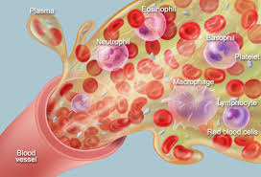
Example:
Plasma is like…
Try your Ciencia Forense book

Slide 6
EXAMPLE:
Plasma in the blood is similar to "lifting" because plasma carries everything including waste and nutrients to the appropriate areas to get used or thrown away,
and "lifting" is taking all the evidence from a scene to either be used by detectives as possible evidence to solve the case or evidence that cannot be used.
Function
Compare and Why
Look on page 91 of the "Ciencias Forense" book

Slide 7
Ready,
get set
and make an analogy for…

Slide 8
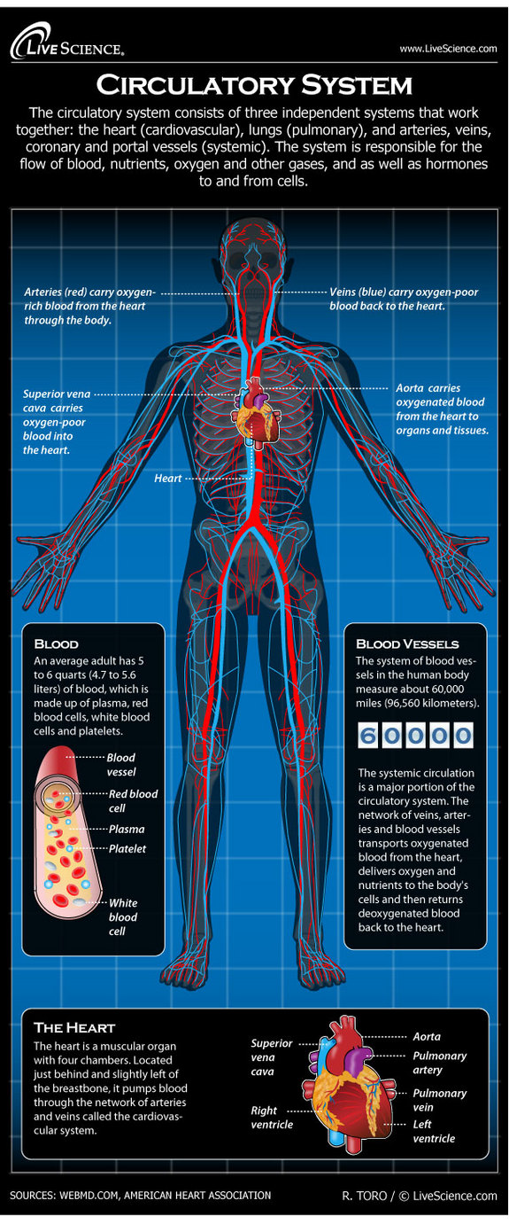
You have 8 minutes…

Slide 9
Teamwork (1-point)
Using the text to find an analogy (1-point)
Explanation of the analogy (1-point)
Creative analogy (1-point)
Everyone in the group participates(1-point)

Slide 10
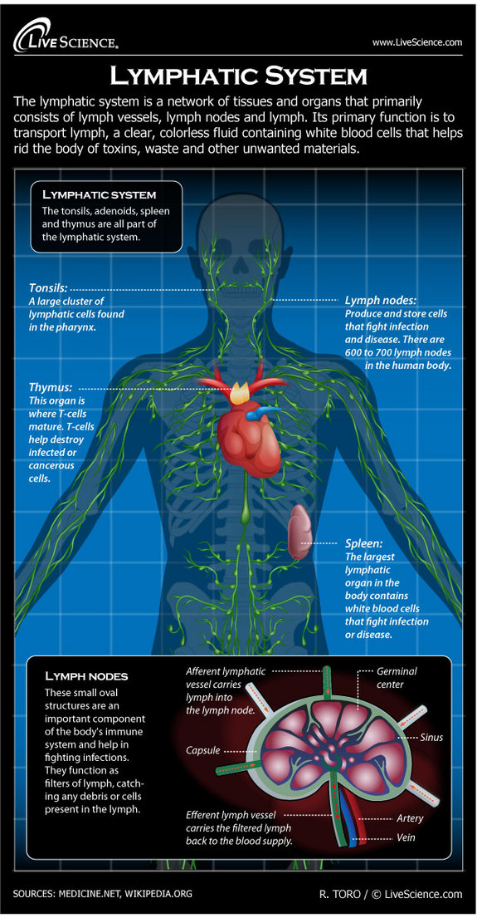
You have 8 minutes…

Slide 11
Teamwork (1-point)
Using the text to find an analogy (1-point)
Explanation of the analogy (1-point)
Creative analogy (1-point)
Everyone in the group participates(1-point)

Slide 12
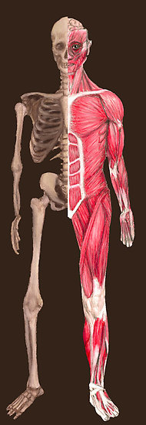
How do the skeletal and muscle systems work together?
Create an analogy to explain your answer.
You have 8 minutes…

Slide 13
Teamwork (1-point)
Using the text to find an analogy (1-point)
Explanation of the analogy (1-point)
Creative analogy (1-point)
Everyone in the group participates(1-point)

Slide 14
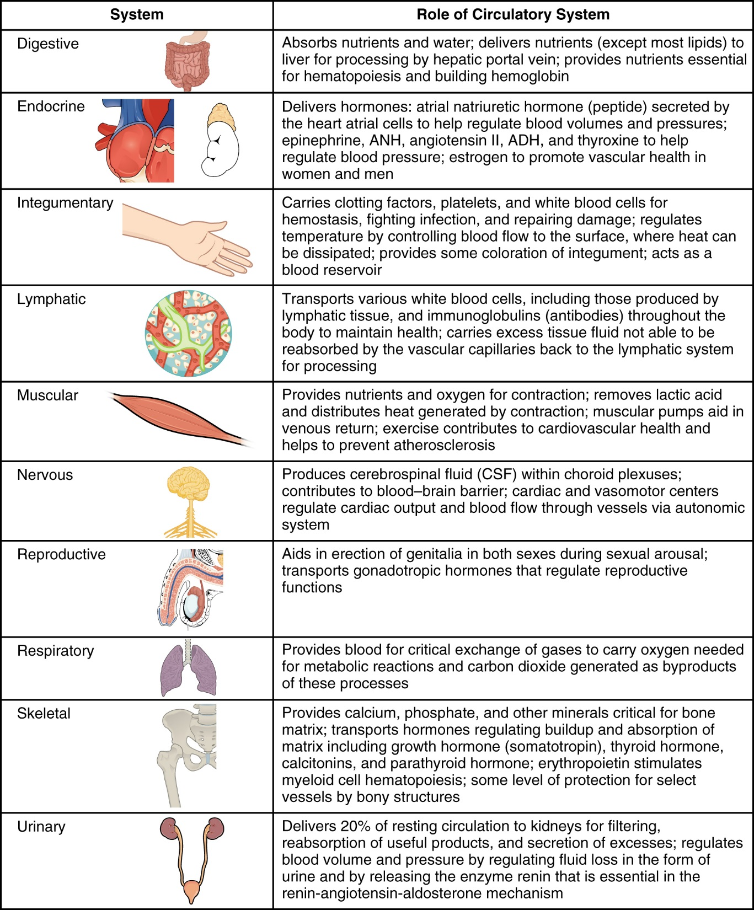
How does the muscular system interact with the circulatory system?
Pick one from below to create an analogy.

Slide 15
Teamwork (1-point)
Using the text to find an analogy (1-point)
Explanation of the analogy (1-point)
Creative analogy (1-point)
Everyone in the group participates(1-point)

Slide 16
Now let’s try with a malfunction.

Slide 17
Teamwork (1-point)
Using the text to find an analogy (1-point)
Explanation of the analogy (1-point)
Creative analogy (1-point)
Everyone in the group participates(1-point)

Slide 19
Review your indicators
CR1 and CR2
Be very specific in your answers.

Slide 20
On a new sheet of paper:
You pick one system we have studied and explain to your patient:
One component and its’ function using an analogy
One interaction using and analogy
One malfunction using an analogy what is wrong using an analogy. (CR1)

Slide 21
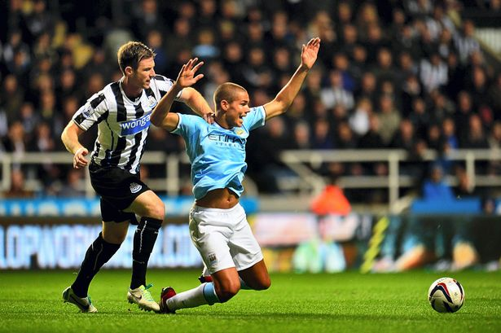
Your patient has twisted his ankle. He has a grade II sprain.
Explain to your patient the necessary steps in his treatment to get better using an analogy or analogies.
Is this injury severe for your patient? Why?
Review CR2 before your start

