Slide 1
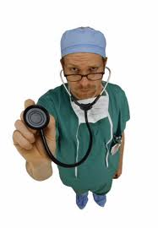
Ready to be Medical Students
You will need to read the scenarios carefully and help the patient to get better if necessary.
We have not studied all the systems
present, but use this example to make your answers as close to Excellent as possible.

Slide 2
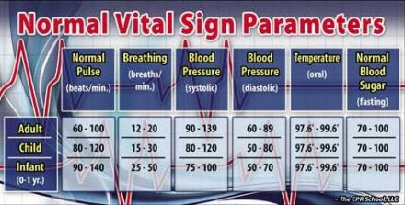

Slide 3
A patient male 20 years old visiting from Spain, was admitted to the emergency department with weakness, nausea, vomiting and diarrhea. He reported that he was eating pizza at a dinner last night, in a restaurant in Santa Marta with his friends. He was very thirsty and had 5 fresh lemonades. The symptoms appeared the morning after, with pain in the upper area of the abdomen. During the day, he had headache and kind of disorientation. In the afternoon, after approximately 30 hours, the symptoms got worse. None of his friends have symptoms. His blood pressure is 90/55. His body temperature is 110 degrees. His breathing is less than 10 breaths a minute.

Slide 4
a. What systems are involved in this scenario? (CT2)
b. How are the systems being affected? (CT2)
c. Which components are working harder and which components are working less? (CT2)

Slide 5
A patient male 20 years old visiting from Spain, was admitted to the emergency department with weakness, nausea, vomiting and diarrhea. He reported that he was eating pizza at a dinner last night, in a restaurant in Santa Marta with his friends. He was very thirsty and had 5 fresh lemonades. The symptoms appeared the morning after, with pain in the upper area of the abdomen. During the day, he had headache and kind of disorientation. In the afternoon, after approximately 30 hours, the symptoms got worse. None of his friends have symptoms. His blood pressure is 90/55. His body temperature is 110 degrees. His breathing is less than 10 breaths a minute.

Slide 6
a.The systems affected are the digestive system, excretory system, circulatory system, lymphatic system, and respiratory system.
b.The digestive system is in pain with pain possibly in the stomach. The excretory system is working faster getting all the toxins out of the body as quickly as possible with the vomiting and diarrhea. The circulatory system shows his blood pressure is low, so it is working slower and he has a headache that could be because of his blood pressure. His lymphatic system has started to attack the infection or bacteria because he has a very fever. His breathing is very slow and this affects his respiratory system by not getting enough oxygen to parts of his body.
c.The intestines and esophagus are working harder to release all the toxins quickly. The lymph nodes will need to attack faster with the white blood cells. The heart is pumping slower and the pressure is low because he does not have enough nutrients to keep the system working properly.

Slide 7
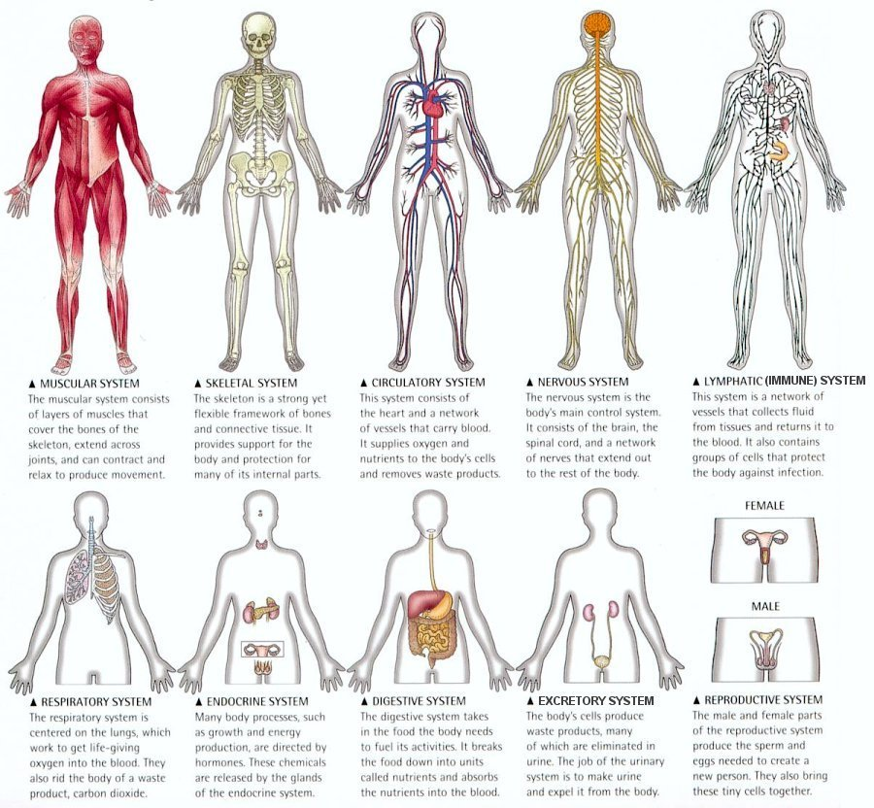

Slide 8
d.Make a diagnosis. (CT1)
e.What can the patient do to get better? (CT1)
f. Explain to the patient what is happening in their body by using an analogy. (Practice for CR1)
g. Explain to the patient, if they are in serious danger or if it is normal for their body to react in this way.

Slide 9
A patient male 20 years old visiting from Spain, was admitted to the emergency department with weakness, nausea, vomiting and diarrhea. He reported that he was eating pizza at a dinner last night, in a restaurant in Santa Marta with his friends. He was very thirsty and had 5 fresh lemonades. The symptoms appeared the morning after, with pain in the upper area of the abdomen. During the day, he had headache and kind of disorientation. In the afternoon, after approximately 30 hours, the symptoms got worse. None of his friends have symptoms. His blood pressure is 90/55. His body temperature is 110 degrees. His breathing is less than 10 breaths a minute.

Slide 10
d. My diagnosis is he has had an allergic reaction to the water from the 5 lemonades he drank the night before. The water is not treated and he has some parasites in his system. He is dehydrated because of all the vomit and diarrhea and needs to replenish his liquids quickly.
e. The patient will need to rehydrate. He is almost done cleaning his system. He will need to stay in the hospital one more night and drink a lot of liquids with salt (electrolytes) to get the balance back in his body. I will give him something for the pain, like aspirin.

Slide 11
d.Make a diagnosis. (CT1)
e.What can the patient do to get better? (CT1)
f. Explain to the patient what is happening in their body by using an analogy. (practice for CR1)
g. Explain to the patient, if they are in serious danger or if it is normal for their body to react in this way. (CT1)

Slide 12
f. Mr. Patient, your body has some nasty friends attacking your intestines. Your body reacted to the parasites that are found in the water in Santa Marta. The lemonade most likely was not made with bottles or potable water. You basically invited some crazy friends to a party in your body and they made a big mess. Your body has asked them to leave by attacking the body with diarrhea and vomit and soon those nasty friends will be gone.
g. This is a normal reaction to something that you are not used to. Your body reacted to untreated water. It is unpleasant to feel this way, but next time be careful with the water you drink while traveling. You will feel better soon. If your body continues to react this way for a long period of time, it will be serious.

Slide 13
Your Turn…
You will do one with a partner and the second one individually.

