Slide 1
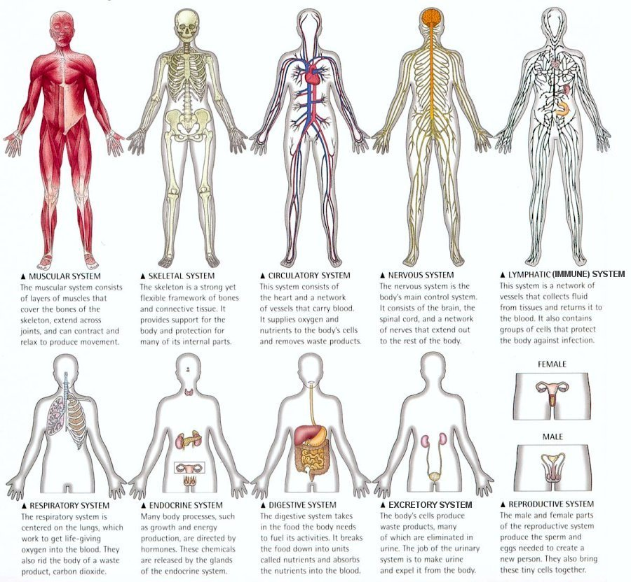
Atoms
Cells
Tissues
Organs
Systems
HOMEOSTASIS
Balance!!
Analogy: with books in Spanish class and in English class

Slide 2
CR1.
Integrates information about the systems of the human body to create analogies about their components, functions, interactions, and malfunctions
You will explain to “patients” using analogies about places, things, characters from stories, events from the books you are reading in Spanish and in English

Slide 3
An Analogy is when you take two different things
and find a similarity to explain or clarify something.
Analogies are great for doctors because doctors can help patients understand their bodies better.
Examples:
The nervous system is like the government because it controls the body like the government controls the city.
The circulatory system is like the transportation system because the blood vessels and heart transport nutrients and wastes in the body like roads and vehicles transport people and goods in the city.
BUT you can also say,
The circulatory system is like the water and drainage system because the blood is transported in the vessels and filtered in special organs like the city has an underground water purification system that transports the necessary water.
The skeletal system is like the general structure of the city because the bones define the shape and structure of the body and the buildings, foundations, and size are the base structure of a city.
The lymphatic system is like the defense system because lymph recognize antibodies and protect/attack when necessary and the police, military and hospitals protect the citizens when necessary.
The digestive and the excretory systems work together like the markets, government, and garbage disposal agency work together because we consume foods that provide nutrients and we excrete waste and markets provide what we need and the government and garbage disposal agency pick up our daily garbage.

Slide 4
You cannot use those examples!!!
You must be creative and use the stories, characters, events and ideas
from the books you are reading.
Example: On pages 50-51 of the Spanish Forensic book
All the characters are working together to solve the crime. The botanist, the microbiologist, the veterinarian, the detectives, and the geologist work in their specialty to bring the criminal to justice.
Similarly in the human body, all the systems circulatory, nervous, muscular etc.. specialize in specific jobs to keep the body working properly. They all have to communicate and work together

Slide 5
You will be Medical Students…
CR2.
Transforms the necessary information about the systems of the human body to play the role of a physician to diagnose illnesses, malfunctions within the system, or deduce normal problems of gross anatomy
Homework: Video on the student weebly page. Notice analogies and how they pretend to be doctors.

Slide 6

NO
Human Body Parts (Be Mature) 2) Medical Student Syndrome

Slide 7
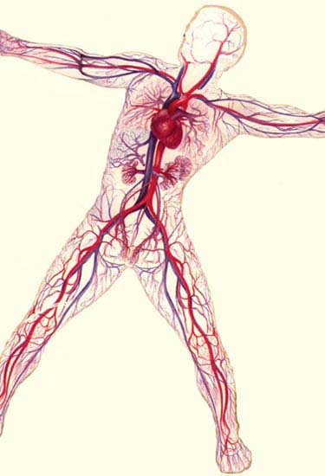

Slide 8
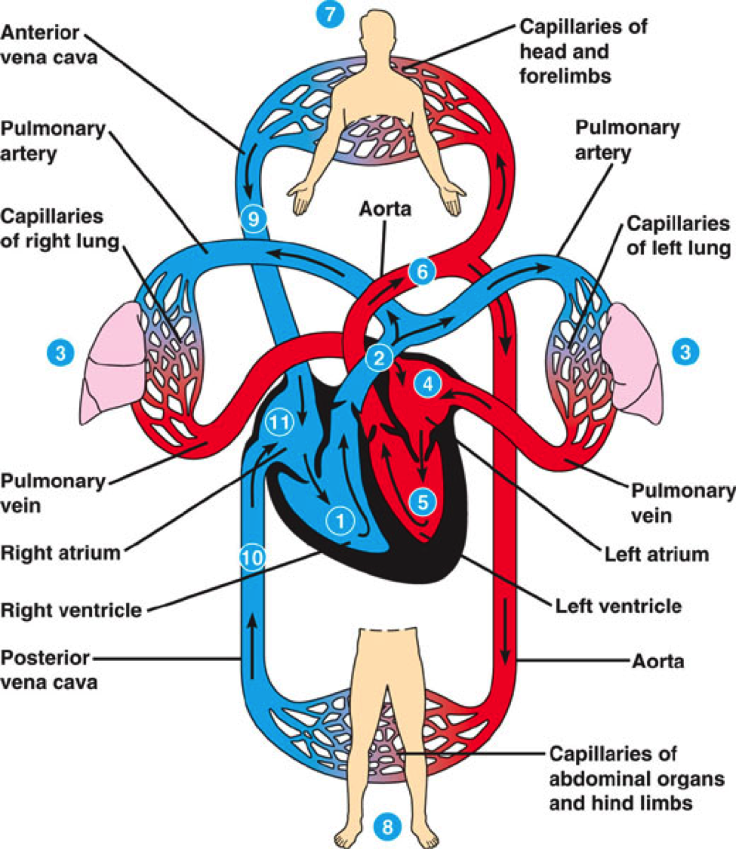

Slide 9
Notes:
Square 1

Slide 10
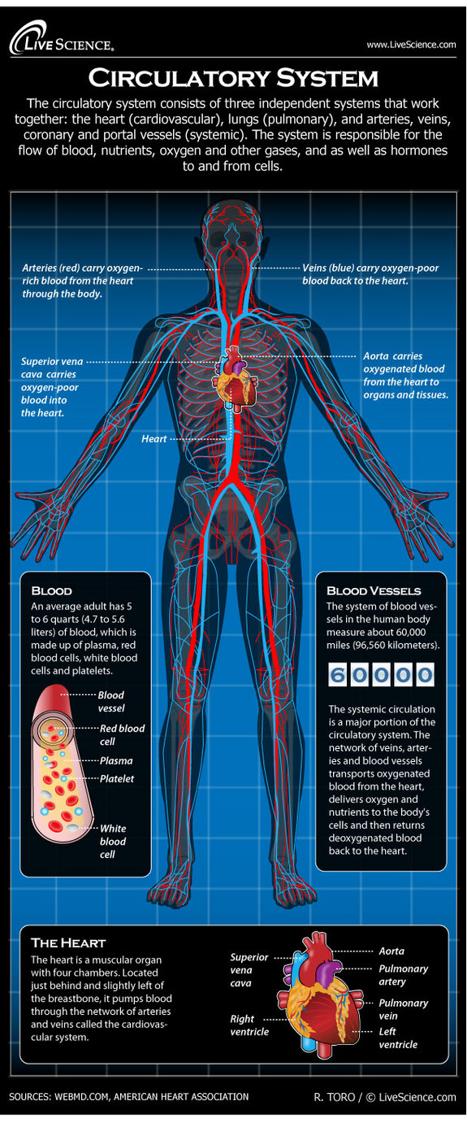

Slide 11
The Circulatory System: Functions
Transports blood, nutrients, oxygen and other gases and hormones throughout the body
Arteries (red): oxygenated blood away from the heart
Aorta: Takes oxygenated blood directly from the heart to the organs and other parts
Veins (blue): takes blood with a little bit of oxygen or deoxygenated to the heart
Blood: has plasma (carries nutrients and waste), red blood cells (carries oxygen), white blood cells (helps immune system), and platelets (helps clotting)
Heart: muscle that pulls and pushes the blood to get oxygenated
__
Notes:
Square 2

Slide 12
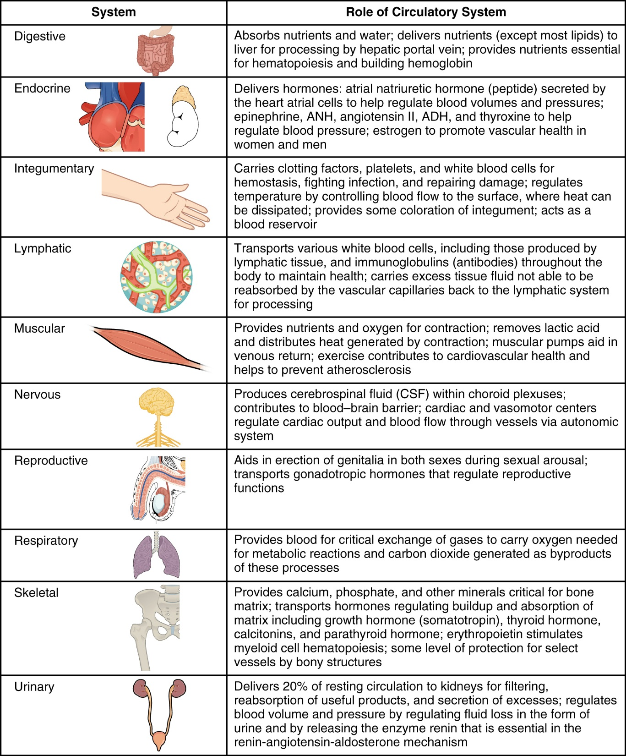

Slide 13
The Circulatory System: Interactions
Digestive System: takes the nutrients and waters and delivers it to the blood through a process
Endocrine System (hormones): Blood takes the hormones to parts of the body and watches Blood Pressure
Respiratory: Transfers oxygen to the blood in the lungs
Skeletal: Blood takes vitamins and minerals to the bones
Integumentary (skin): holds the blood in and helps to transport white cells and platelets
__
Notes:
Square 3

Slide 14
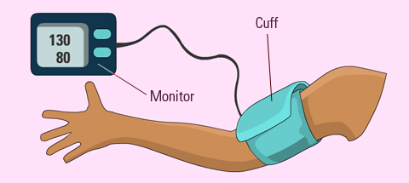
Long-Term Consequences of High Blood Pressure
When someone has high blood pressure, the heart and arteries have a much heavier workload. The heart must pump harder and the arteries are under greater strain as they carry blood. If high blood pressure continues for a long time, the heart and arteries may no longer work as well as they should. Other organs that are receiving the blood, like the kidneys and brain, may also be affected.
Having high blood pressure puts someone at a higher risk for stroke, heart attack, kidney failure, loss of vision, and atherosclerosis (hardening of the arteries).
While high blood pressure doesn't always cause symptoms, it still affects the body and puts a person at risk for those long-term health problems. In rare cases, severe hypertension can cause headaches, visual changes, dizziness, nosebleeds, heart palpitations, and nausea.
HYPERTENSION
(high)
Treating High Blood Pressure
If an underlying illness is causing hypertension, treating that illness may be enough to get the blood pressure back to normal. If there's no underlying illness, the doctor may recommend weight loss, increased intake of fruits and vegetables, decreased salt intake, increased exercise, and even relaxation techniques.

Slide 15
Low blood pressure is also known as hypotension. If symptoms are mild hypotension usually requires no treatment. However, it can cause serious heart disorders, fainting and also lead to neurological and endocrine disorders. If hypotension is severe key organs can become deprived of oxygen and nutrients and the body can go into shock, a life-threatening condition.
HYPOTENSION (Low)
What is low blood pressure (hypotension)?
Anybody with a reading if 90/60 mmHg or lower is regarded as having hypotension (low blood pressure). People with low blood pressure have some protection from factors which raise blood pressure to undesirable levels. However, low blood pressure may be a sign of an underlying problem, and can cause unpleasant symptoms.
If blood pressure is so low that the supply of blood to the brain and other vital organs is insufficient the patient will need medical attention. Severe hypotension is caused by an underlying illness or condition
Treatments
Salt and fluids
Increasing salt intake may improve the symptoms of hypotension, especially for those with postural hypotension. This can be done either by taking salt tablets or adding more salt to food. It is important to make sure your fluid intake is adequate - ask your doctor how much fluid (water) you should ideally consume each day. Fluids increase blood volume and prevent dehydration - both have an impact on blood pressure levels.
Compression stockings
These help stimulate circulation.

Slide 16
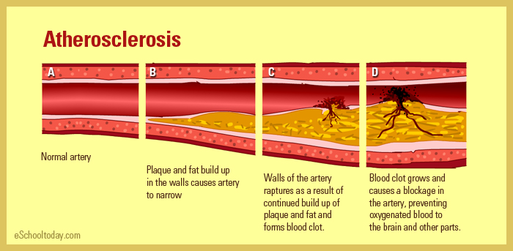
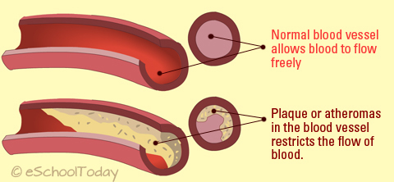
Atherosclerosis
Atherosclerosis, occurs when arteries (vessels carrying oxygen-rich blood to the brain and other body parts) become clogged up by fatty substances (also called plaques or atheromas), such as cholesterol. Plaques or atheromas cause arteries to harden and narrow-up, resulting in restricted blood flow or plaque raptures, which then clots the blood. When this happens, it can block blood flow and result in a stroke and heart attack. Some experts say that Atherosclerosis itself is not the disease, but a risk factor.
Treatment and Prevention of Atherosclerosis
There is treatment available for Atherosclerosis, and it aims to prevent Atherosclerosis from degenerating into a heart attack. Your doctor will take you through some medications. Additionally, lifestyle changes such as eating a healthier diet and increasing exercise can help you minimize the risks.

Slide 17
The Circulatory System: Malfunctions and *Alterations
Hypertension: heart and arteries pump harder/blood pressure is high
SYMPTOMS: usually none, but dizziness, headaches
Prevention and TREATMENT: low-salt diet, increase exercise, learn to relax
Hypotension: not enough oxygenated blood reaches organs and brain/blood pressure is low
SYMPTOMS: hormone imbalance, fainting
TREATMENT: more salt and water in diet, special socks to help circulation
Arthrosclerosis: fatty stuff does not allow blood to flow easily and some plaque can later stop the flow completely
SYMPTOMS: usually no symptoms, until heart attack or stroke
Prevention and TREATMENT: eating healthy and increase exercise
*Blood Pressure and heart rate decreases naturally: while sleeping the circulatory relaxes a little and recovers from the day
Notes:
Square 4

Slide 18

While you sleep…
Your blood pressure and heart rate decrease.
When you're resting, your body doesn't need to work as hard or pump as much blood, so these systems slow down. Blood pressure needs to dip at night so your cardiac muscle and circulatory system have time to relax and repair, says Dr. Breus. It's especially important for people with high blood pressure to get at least seven hours of sleep to experience that temporary drop-it reduces the risk for heart disease. And if you have sleep apnea, get treatment right away because that condition can increase nighttime blood pressure, says Dr. Breus.

Slide 20
Read Pages 21-22 of the “Ciencias Forense” to get ready for the lab on December 1st
GET PERMISSION: BLOOD TYPES

Slide 21
Next week:
Your Turn
The Lymphatic System

Slide 22
The Lymphatic System: Components | The Lymphatic System: Functions
The Lymphatic System: Interactions | The Lymphatic System: Malfunctions

Slide 23
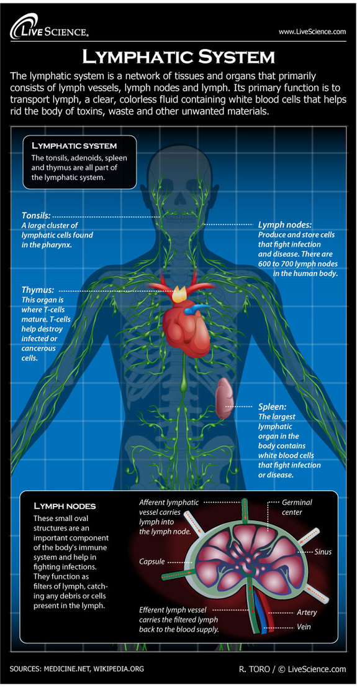

Slide 25
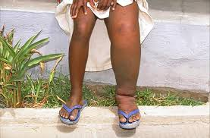
http://youtu.be/ZrAJM71OIAg
Lymph Self-Exam
Infection of the Lymph Nodes

